Slide 1
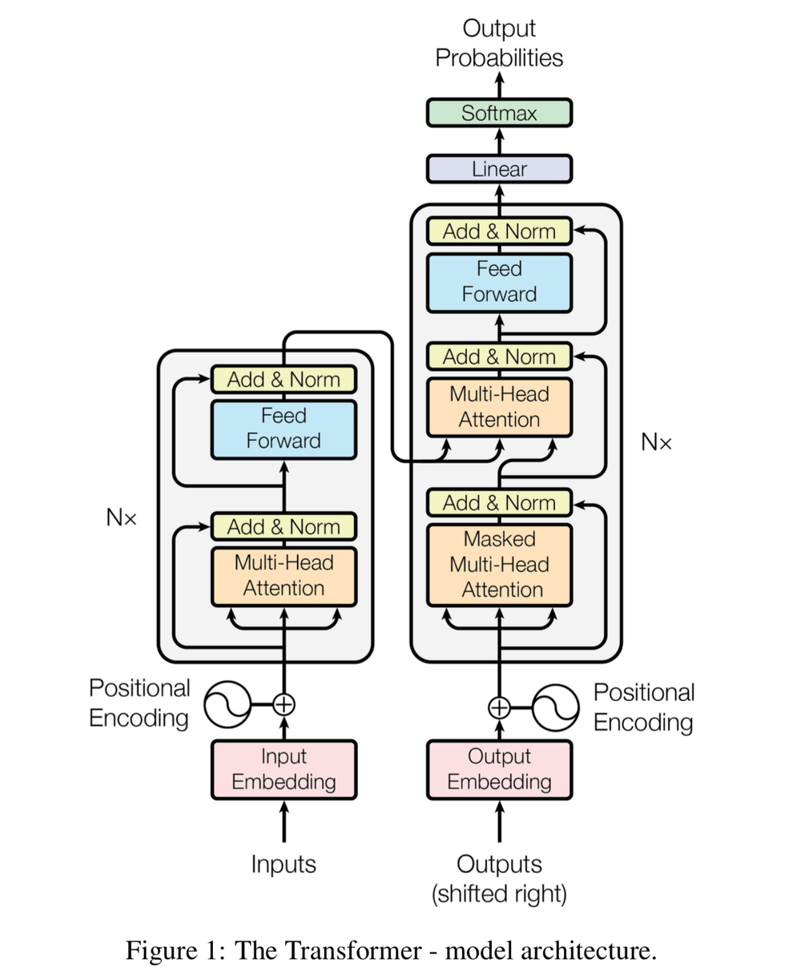
Transformers
TEAM: FUTURE WIZARDS OF AI

Slide 2

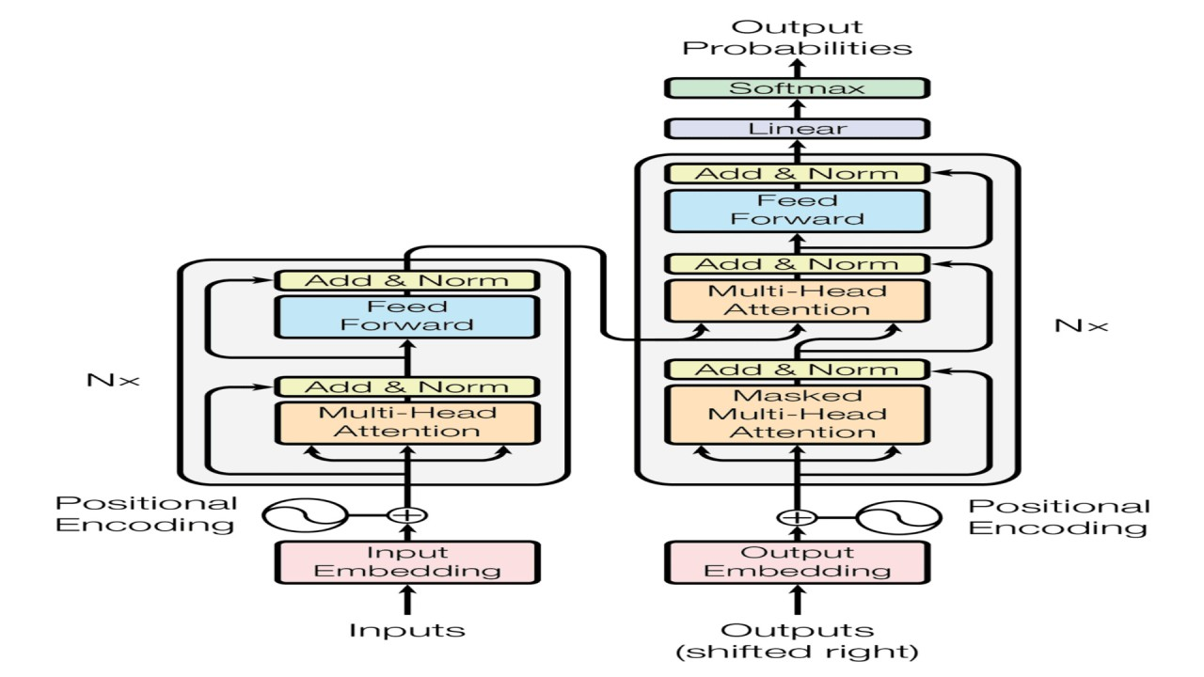
WHEN WE SPEAK OF TRANSFORMERS WHAT’S THE FIRST THOUGHT THAT COMES TO MIND?
OR
WHEN IT COMES TO DEEP LEARNING, IF YOU CHOSE THIS MODEL YOU ARE CORRECT.

Slide 3
Introduction to Transformers
A Revolutionary Leap in AI
Developed by researchers at Google in 2017, the Transformer model introduced a new era in AI, focusing on improving language understanding and generation. Transformers have revolutionized AI's capability to understand and generate human language, offering unparalleled efficiency and accuracy.

Slide 4
Key Features of Transformer Neural Networks
What Sets Them Apart
Attention Mechanisms: Enable focusing on different parts of input data for better context and nuance understanding, akin to prioritizing specific words or phrases in language.\
Sequential Data Handling: Process all parts of data simultaneously, unlike predecessors, enhancing understanding and significantly speeding up training and operation.
Versatility Across Domains: Adapted for a wide range of tasks beyond NLP, including computer vision, finance, healthcare, and even genomics, showcasing their flexibility and efficiency.
Example: OpenAI's GPT Series: Demonstrates the transformative potential of transformers in generating human-like text, answering questions, and creating content that feels human.

Slide 5
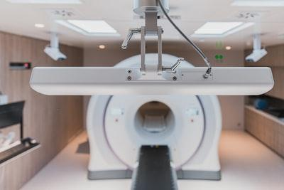
Applications of Transformer Neural Networks
Expanding the AI Horizon
Beyond Natural Language Processing: Transformers are foundational in evolving AI's capabilities in understanding and generating human language, marking a significant leap beyond traditional models.
Computer Vision: Adapted for computer vision tasks, such as image recognition, transformers demonstrate remarkable versatility and accuracy.
Time Series Analysis: Utilized in finance, healthcare, and meteorology, transformers enable advanced analysis of sequential data, improving predictions and insights.
Audio Processing and Genomics: Their application in audio processing, genomics, and signal processing showcases the broad utility of transformers across diverse scientific fields.
Signal Processing: Innovative in processing EEG and seismic data, transformers contribute to advancements in neuroscience and geoscience, respectively.
‎

Slide 6
Challenges and Limitations of Transformer Neural Networks
Navigating the Hurdles
High Resource Demand: Transformers require substantial computational resources and large datasets for training, which can be a barrier for some applications.
Risk of Overfitting: Their capacity for complexity means they can sometimes overfit to training data, especially without sufficient regularization and data diversity.
Limited in Narrow Tasks: While versatile, transformers may not always be the most efficient choice for highly specialized tasks compared to tailored solutions.
Interpretability Challenges: Understanding how transformers make specific decisions can be difficult, posing challenges for applications requiring clear decision-making processes.
‎

Slide 7
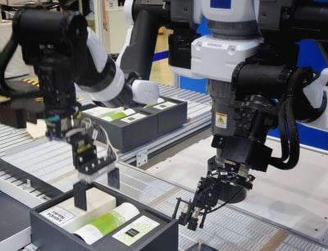
Comparing Architectures: Transformers, CNNs, and RNNs
Application Suitability, Performance, and Efficiency
Transformers: Excel in handling long-range dependencies in text and beyond, with efficient parallel processing and superior performance in NLP and some computer vision tasks.
CNNs: Specialized for image recognition and processing, capturing spatial hierarchies in data, with high efficiency in tasks requiring understanding of visual context.
RNNs: Designed for sequential data, ideal for time series analysis and certain NLP tasks, though challenged by long dependency lengths and slower sequential processing.
Application Suitability: Transformers are versatile, applicable in a wide range of domains; CNNs are the go-to for image tasks; RNNs fit sequential data but are being overtaken by transformers in NLP.
Performance and Efficiency: Transformers offer scalability and parallelism, CNNs provide spatial efficiency, and RNNs face limitations with long sequences but excel in compact sequential tasks.
‎
‎Photo by Possessed Photography on Unsplash

Slide 8
Future Directions for Transformer Neural Networks
Innovation and Improvement Horizons
Enhancing Efficiency: Developing techniques to reduce computational resources and energy consumption without compromising performance.
Data Efficiency Improvements: Innovations to minimize the need for vast amounts of training data, making transformers more accessible for a broader range of applications.
Improving Interpretability: Advancing methods to understand how transformers make decisions, increasing their usability in critical and sensitive areas.
Extending Applicability: Broadening the range of tasks where transformers can be applied, including further inroads into areas like healthcare, environmental science, and beyond.
Integration with Other AI Technologies: Combining transformers with other AI approaches, such as reinforcement learning and generative models, to unlock new capabilities and applications.

Slide 9
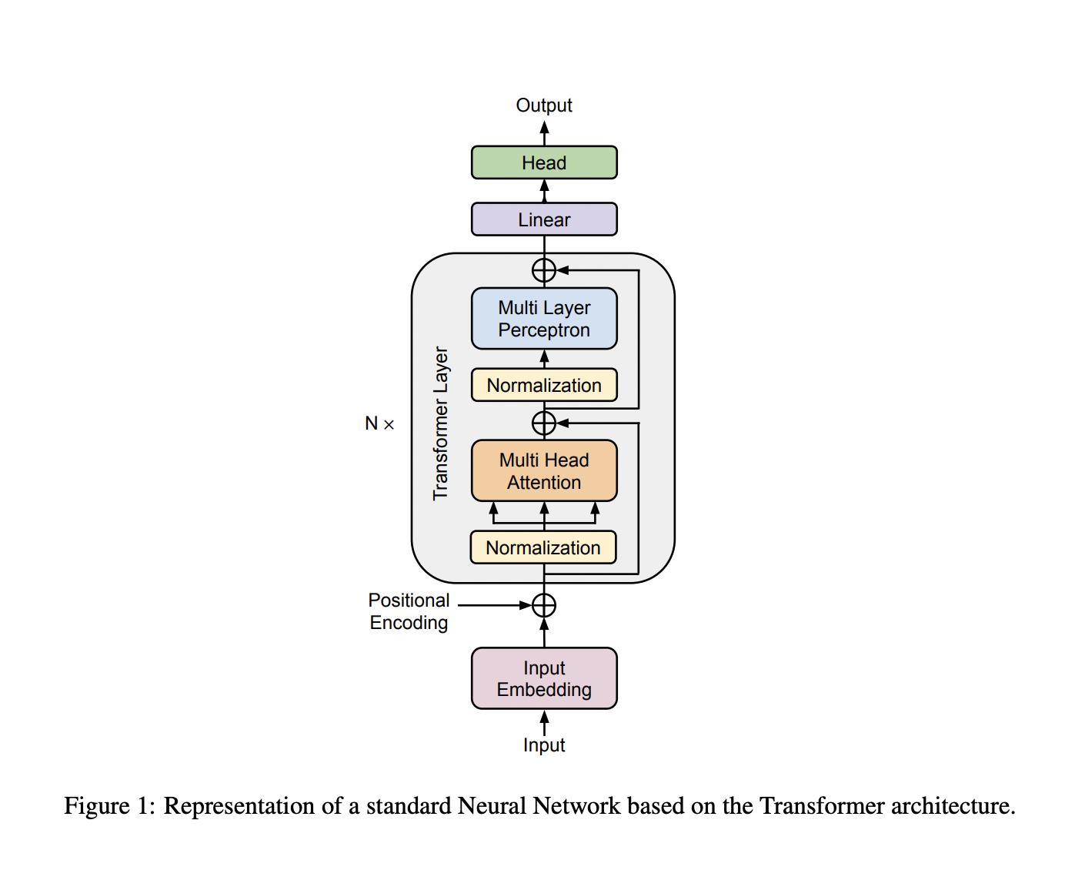
Still confused?
Here’s a short video breaking it down.
https://www.youtube.com/watch?v=8_KVSMupRAw

Slide 10
References
Rick Merritt (NVIDIA); “What Is a Transformer Model?”; https://blogs.nvidia.com/blog/what-is-a-transformer-model/
Giuliano Giacaglia; “How Transformers Work”; https://towardsdatascience.com/transformers-141e32e69591
Wikipedia, “Transformer (deep learning architecture)”; https://en.wikipedia.org/wiki/Transformer_(deep_learning_architecture)
Ankit, U. (2022, June 28). Transformer neural networks: A step-by-step breakdown. Transformer Neural Networks: A Step-by-Step Breakdown. https://builtin.com/artificial-intelligence/transformer-neural-network

Slide 11
Thank You For Watching!
Questions?

